Slide 1



UNIVERSITY INSTITUTE OF ENGINEERING
COMPUTER SCIENCE ENGINEERING
Bachelor of Engineering
Cloud Computing(CST-411)
Prepared By: Ms. Himanshu(E11818)
Topic:AWS
DISCOVER . LEARN . EMPOWER

Slide 2
Overview
Deployment Model of Cloud Computing
What are the uses of cloud service models?
IaaS, PaaS, SaaS
How Do the 3 Cloud Computing Service Models Differ?
Cloud Computing Service Categories
Comparison of Deployment Model
How to Choose Between SaaS vs. PaaS vs. IaaS

Slide 3
AWS
AWS stands for Amazon Web Services .
which uses distributed IT infrastructure to provide different IT resources on demand.

Slide 4

What is AWS?
AWS stands for Amazon Web Services.
The AWS service is provided by the Amazon that uses distributed IT infrastructure to provide different IT resources available on demand. It provides different services such as infrastructure as a service (IaaS), platform as a service (PaaS) and packaged software as a service (SaaS).
Amazon launched AWS, a cloud computing platform to allow the different organizations to take advantage of reliable IT infrastructure.

Slide 5
Uses of AWS
A small manufacturing organization uses their expertise to expand their business by leaving their IT management to the AWS.
A large enterprise spread across the globe can utilize the AWS to deliver the training to the distributed workforce.
An architecture consulting company can use AWS to get the high-compute rendering of construction prototype.
A media company can use the AWS to provide different types of content such as ebox or audio files to the worldwide files.

Slide 6
Pay-As-You-Go
Based on the concept of Pay-As-You-Go, AWS provides the services to the customers.
AWS provides services to customers when required without any prior commitment or upfront investment. Pay-As-You-Go enables the customers to procure services from AWS.
Computing
Programming models
Database storage
Networking

Slide 7
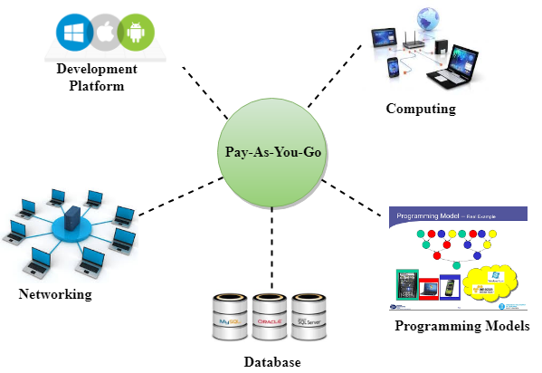

Slide 8
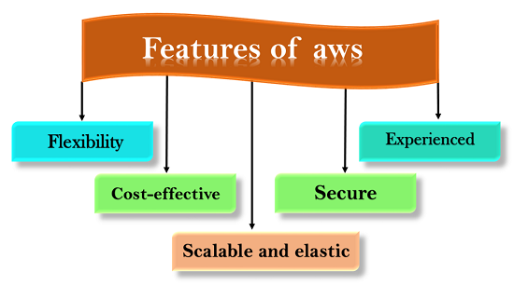

Slide 9
Advantages of AWS
1) Flexibility
We can get more time for core business tasks due to the instant availability of new features and services in AWS.
It provides effortless hosting of legacy applications. AWS does not require learning new technologies and migration of applications to the AWS provides the advanced computing and efficient storage.
AWS also offers a choice that whether we want to run the applications and services together or not. We can also choose to run a part of the IT infrastructure in AWS and the remaining part in data centres.

Slide 10
2) Cost-effectiveness
AWS requires no upfront investment, long-term commitment, and minimum expense when compared to traditional IT infrastructure that requires a huge investment.
3) Scalability/Elasticity
Through AWS, autoscaling and elastic load balancing techniques are automatically scaled up or down, when demand increases or decreases respectively. AWS techniques are ideal for handling unpredictable or very high loads. Due to this reason, organizations enjoy the benefits of reduced cost and increased user satisfaction.

Slide 11
4) Security
AWS provides end-to-end security and privacy to customers.
AWS has a virtual infrastructure that offers optimum availability while managing full privacy and isolation of their operations.
Customers can expect high-level of physical security because of Amazon's several years of experience in designing, developing and maintaining large-scale IT operation centers.
AWS ensures the three aspects of security, i.e., Confidentiality, integrity, and availability of user's data.

Slide 12
Disadvantages of Amazon Web Services
AWS can be complex, with a wide range of services and features that may be difficult to understand and use, especially for new users.
AWS can be expensive, especially if you have a high-traffic application or need to run multiple services. Additionally, the cost of services can increase over time, so you need to regularly monitor your spending.
While AWS provides many security features and tools, securing your resources on AWS can still be challenging, and you may need to implement additional security measures to meet your specific requirements.
AWS manages many aspects of the infrastructure, which can limit your control over certain parts of your application and environment.

Slide 13
challenges or issues while using AWS
Using AWS (Amazon Web Services) can sometimes come with a few challenges or issues. Here are some common problems that users may encounter while working with AWS:
Cost Management: AWS offers a wide range of services, and costs can quickly add up if resources are not managed effectively. It's important to monitor and optimize resource usage to avoid unexpected bills.
Security and Compliance: AWS provides robust security features, but misconfigurations or inadequate access controls can lead to vulnerabilities. Maintaining security best practices and complying with relevant regulations is crucial.

Slide 14
Service Limitations: Certain AWS services have default limitations on usage, such as the maximum number of instances or storage capacity. Hitting these limits may require requesting service limit increases or finding alternative solutions.
Complexity and Learning Curve: AWS has a vast ecosystem with numerous services and features, which can be overwhelming for newcomers. Understanding the intricacies of different services and effectively architecting solutions may require time and effort.
Performance and Scalability: Configuring resources for optimal performance and scalability can be challenging. Poorly designed architectures or misconfigured settings may result in sluggish performance or difficulties in scaling applications.

Slide 15
Integration and Interoperability: Integrating AWS services with existing on-premises systems or third-party applications can be complex. Compatibility issues, data transfer challenges, and proper API usage need to be considered.
Downtime and Service Disruptions: Although AWS aims for high availability, service disruptions or outages can occur. Planning for potential downtime, implementing fault-tolerant architectures, and utilizing multi-region strategies can mitigate the impact.
Support and Documentation: While AWS offers extensive documentation and resources, finding specific information or troubleshooting problems can be challenging. Utilizing support channels like forums, documentation, and contacting AWS support may be necessary.

Slide 16
AWS Services
Amazon Web Services (AWS) is a comprehensive cloud computing platform offered by Amazon.
It provides a wide range of services that enable businesses and individuals to build and deploy applications, store and analyze data, and scale their infrastructure as needed.
Here are some key AWS services:

Slide 17
Amazon Elastic Compute Cloud (EC2): Provides virtual servers in the cloud.
  AWS Lambda: Runs your code in response to events without managing the underlying infrastructure.
  Amazon Elastic Container Service (ECS): Orchestrates and manages Docker containers.
  AWS Batch: Runs batch computing workloads on the cloud.
Storage Services:
  Amazon Simple Storage Service (S3): Provides scalable object storage for files and data.
  Amazon Elastic Block Store (EBS): Offers persistent block-level storage volumes for EC2 instances.
  Amazon Glacier: Secure and durable object storage for data archiving and long-term backup.
  AWS Snowball: A petabyte-scale data transport solution for physically transferring large amounts of data.

Slide 18
Database Services:
Amazon Relational Database Service (RDS): Managed database service for MySQL, PostgreSQL, Oracle, SQL Server, etc.
Amazon DynamoDB: Fully managed NoSQL database service.
Amazon Aurora: High-performance, fully managed relational database.
Amazon Redshift: Fully managed data warehousing service.

Slide 19
Networking Services:
Amazon Virtual Private Cloud (VPC): Isolated virtual network infrastructure.
AWS Direct Connect: Establishes a dedicated network connection between on-premises and AWS.
Elastic Load Balancing: Distributes incoming traffic across multiple EC2 instances.
Amazon Route 53: Scalable domain name system (DNS) web service.

Slide 20
Analytics Services:
  Amazon Kinesis: Collect, process, and analyze streaming data.
  Amazon Athena: Query data in S3 using SQL without the need for infrastructure management.
  Amazon Redshift: Data warehousing and analytics service.
  AWS Glue: Fully managed extract, transform, and load (ETL) service.
AI and Machine Learning Services:
  Amazon Recognition: Deep learning-based image and video analysis.
  Amazon Comprehend: Natural language processing for extracting insights from text.
  Amazon Sage Maker: Fully managed service to build, train, and deploy machine learning models.
  Amazon Lex: Build conversational interfaces using voice and text.

Slide 21
Management and Governance Services:
AWS Identity and Access Management (IAM): Manage user access and permissions.
AWS Cloud Formation: Automated infrastructure deployment and management.
AWS Cloud Watch: Monitoring and management of resources and applications.
AWS Trusted Advisor: Provides recommendations to optimize your AWS infrastructure.

Slide 22
AWS Global Infrastructure
AWS is a cloud computing platform which is globally available.
Global infrastructure is a region around the world in which AWS is based. Global infrastructure is a bunch of high-level IT services which is shown below:
AWS is available in 19 regions, and 57 availability zones in December 2018 and 5 more regions 15 more availability zones for 2019

Slide 23
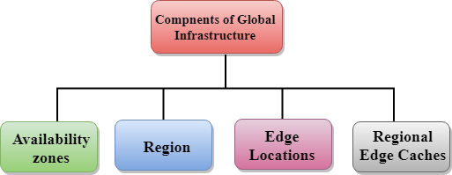
The following are the components that make up the AWS infrastructure:
Availability Zones
Region
Edge locations
Regional Edge Caches

Slide 24
Availability zone as a Data Center
An availability zone is a facility that can be somewhere in a country or in a city. Inside this facility, i.e.,
Data Centre, we can have multiple servers, switches, load balancing, firewalls.
The things which interact with the cloud sits inside the data centers.
An availability zone can be a several data centers, but if they are close together, they are counted as 1 availability zone.

Slide 25
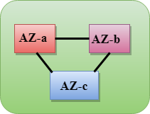
Region
A region is a geographical area. Each region consists of 2 more availability zones.
A region is a collection of data centers which are completely isolated from other regions.
A region consists of more than two availability zones connected to each other through links.
Availability zones are connected through
redundant and isolated metro fibers.

Slide 26
Edge Locations
Edge locations are the endpoints for AWS used for caching content.
Edge locations consist of CloudFront, Amazon's Content Delivery Network (CDN).
Edge locations are more than regions. Currently, there are over 150 edge locations.
Edge location is not a region but a small location that AWS have. It is used for caching the content.
Edge locations are mainly located in most of the major cities to distribute the content to end users with reduced latency.
For example, some user accesses your website from Singapore; then this request would be redirected to the edge location closest to Singapore where cached data can be read.

Slide 27
Regional Edge Cache
AWS announced a new type of edge location in November 2016, known as a Regional Edge Cache.
Regional Edge cache lies between CloudFront Origin servers and the edge locations.
A regional edge cache has a large cache than an individual edge location.
Data is removed from the cache at the edge location while the data is retained at the Regional Edge Caches.
When the user requests the data, then data is no longer available at the edge location.
Therefore, the edge location retrieves the cached data from the Regional edge cache instead of the Origin servers that have high latency.

